Slide 1

Handling Missing Values
Using SQL

Slide 2
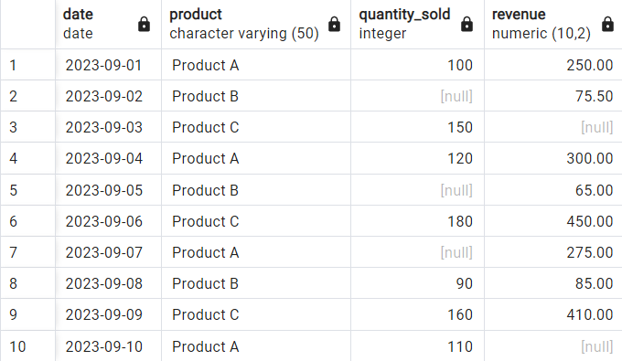
What Is Missing Value
Missing data refers to information or values that are absent or not recorded for certain variables within a dataset.
In the dataset, for instance, there are instances where the columns ‘quantity Sold' and ‘revenue' lack recorded values, indicating the presence of missing data in these specific data fields.
Missing Values

Slide 3
How Is a Missing Value Represented in a Dataset?
Missing values within the dataset are often depicted as empty fields.
Within SQL terminology, the term NULL is employed to indicate the absence of a data value within the database.
In the Pandas library, the absence of data is commonly denoted as NaN, which is short for "Not a Number."

Slide 4
4 Methods used to handling the Missing value in dataset
Deleting the Missing Values
Imputation
LOCF & NOCB
Linear Interpolation

Slide 5
Deleting The Missing Values
The most straightforward approach for dealing with missing values is to either eliminate rows or columns that contain them. But, this action carries the risk of discarding valuable data points, potentially resulting in reduced accuracy.

Slide 6
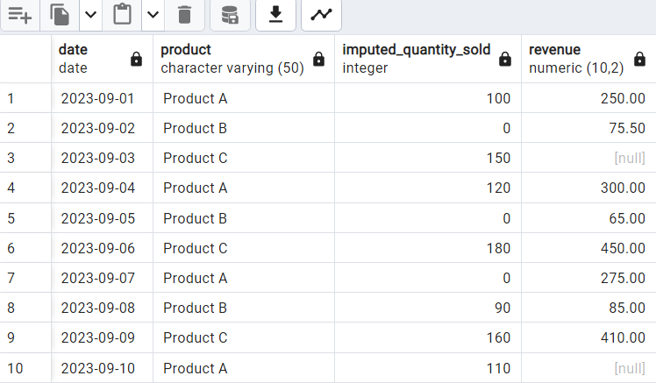
Imputation
Imputing missing values is often regarded as the preferred choice because removing them can reduce the number of available records, potentially affecting overall accuracy.
In this query, we're replacing missing values in the quantity_sold column with 0 using the ‘COALESCE’ function.

Slide 7
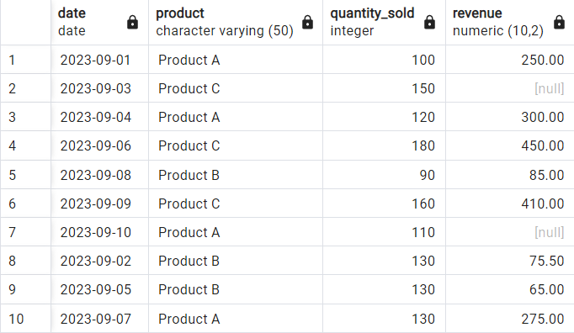
Imputation By Mean
In this method, you have the option to substitute missing values in a column with its calculated mean or average. It's important to note that this approach is exclusively applicable to numerical variables.
We calculate the mean of the quantity_sold column using AVG() only for non-null values.
We then use an UPDATE statement to set the missing values in the quantity_sold column to the calculated mean value.

Slide 8
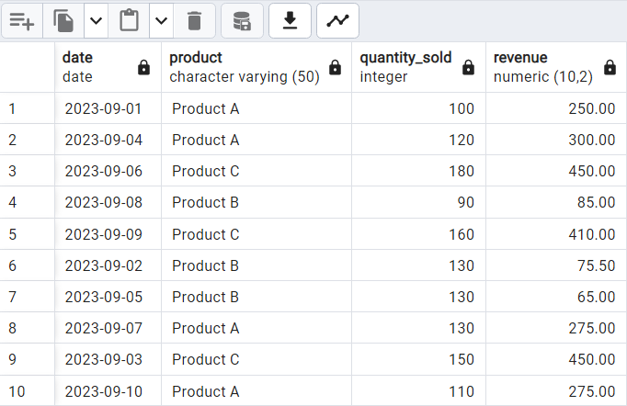
Imputation By Median
To address the issue of outliers during imputation by mean, an alternative is to replace NULL values with the median of the column. It's crucial to remember that this approach is exclusively applicable to numerical variables and does not take into account correlations among features.
We calculate the median of the ‘revenue’ column for each product group. The subquery inside the ‘SET’ clause calculates the median using the ‘ORDER BY’ and ‘LIMIT’ clauses.
We update the missing values in the ‘revenue’ column with the calculated median value.

Slide 9
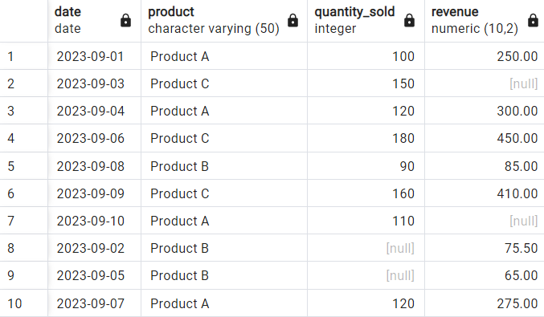
Last Observation Carried Forward (LOCF)
The LOCF method involves carrying forward the most recent observed value to replace missing values. It is particularly useful when dealing with data that has a natural order, such as time or sequential ID.
We're updating the ‘quantity sold’ column with the most recent observed value for each product based on the date column.
The ‘ORDER BY’ x.date ‘DESC’ ensures that we get the most recent value.
The ‘LIMIT 1’ clause ensures that we only select one matching row, which is the most recent observation. We're only updating rows where ‘quantity sold’ is currently null.

Slide 10
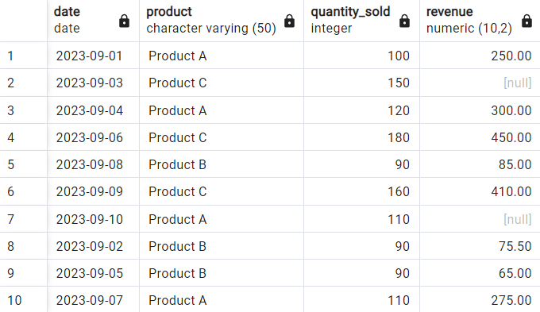
Next Observation Carried Backward(NOCB)
The NOCB method entails carrying backward the next observed value to replace missing values. This approach is especially valuable when working with data that exhibits a natural order, such as time or sequential IDs.
We're updating the ‘quantity sold’ column with the next observed value for each product based on the date column.
The ‘ORDER BY x.date ASC’ ensures that we get the next observation.
The ‘LIMIT 1’ clause ensures that we only select one matching row, which is the next observation. We're only updating rows where ‘quantity sold’ is currently null.

Slide 11
Linear Interpolation
Linear interpolation is a method used to estimate missing values by assuming a linear relationship between known adjacent values. It works particularly well with data that has a natural order, like time-based or sequentially numbered data points.
"Linear interpolation is a method that relies on establishing a linear relationship between neighboring observed values to estimate missing data points.
It proves particularly effective in datasets that exhibit a natural order, such as time series or sequences with incremental IDs.
By connecting adjacent data points with straight-line segments, linear interpolation provides a method for inferring values that fall between known observations.

Slide 12
Why missing data is important?
Data Quality: The presence of missing data can significantly affect the quality and reliability of a dataset. Inaccurate or incomplete data can lead to incorrect conclusions and decisions.
Bias: Missing data can introduce bias into analyses and models. If the missing data is not handled appropriately, it can skew results and lead to incorrect interpretations.
Data Completeness: Missing data may contain valuable information. Ignoring it could mean losing insights that could be crucial for making informed decisions.
Statistical Validity: Missing data can violate assumptions of statistical tests and models. Addressing missing data is essential to ensure the validity of statistical analyses.
Business Impact: a business context, missing data can lead to incorrect business decisions, potentially affecting profitability, customer satisfaction, and overall performance.

Slide 13
What Will Happen If We Ignore The Missing Value
Biased Results: Missing data can introduce bias into your analysis. If the missing data is not missing completely at random (MCAR), it may be related to the variable you're studying, leading to biased results.
Reduced Sample Size: Ignoring missing values reduces the sample size available for analysis. This reduction in sample size can reduce statistical power and may make it more challenging to detect meaningful patterns or relationships.
Incomplete Insights: Missing values may contain valuable information or insights. By ignoring them, you're potentially overlooking critical aspects of your data that could be essential for decision-making.
Inaccurate Models: If you're building predictive models, ignoring missing values can lead to less accurate and less reliable models. Many machine learning algorithms cannot handle missing data directly, so imputation or other handling methods are necessary.
Loss of Information: When you remove rows or columns with missing data, you're discarding information that may be relevant for your analysis. This can result in an incomplete and less informative dataset.

Slide 14
Conclusion
In every dataset, encountering missing values is quite common and necessitates careful handling. The initial step involves thoroughly examining the dataset to identify which variables contain missing data and determining the extent of these gaps, typically expressed as a percentage. Subsequently, the challenge is to select appropriate methods for addressing these gaps.
There is no one-size-fits-all approach for handling missing values; it often involves a process of experimentation and adaptation based on the unique characteristics and context of the data at hand. In essence, the strategy for addressing missing data should be tailored to the specific dataset's nature and content, involving a degree of flexibility and exploration to find the most suitable solution.

